Slide 1

Truss Tool
By: Maryam Valian
This Photo by Unknown Author is licensed under CC BY-SA

Slide 2
Implementation
Module diagram
Input tests
Output tests

Slide 3
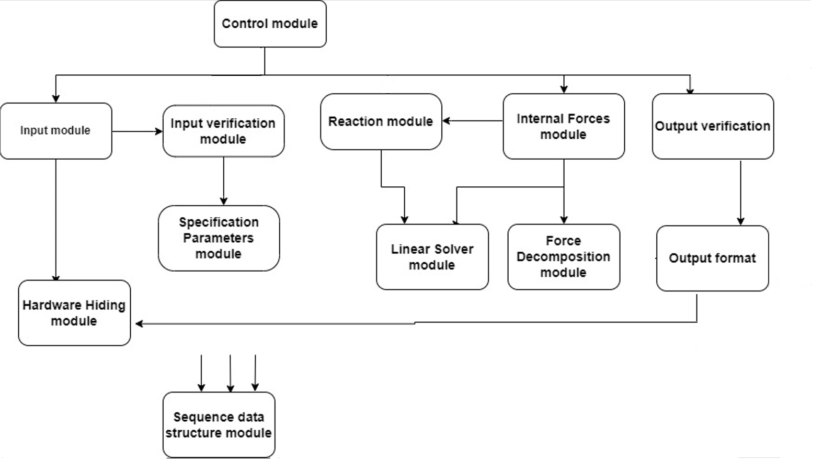
Module diagram

Slide 4
Invalid input tests

Slide 5
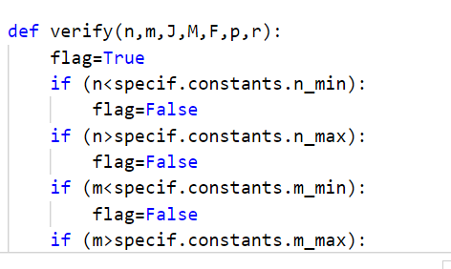
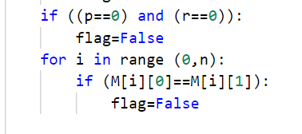
Input verification module
Invalid joint counts : n=2
Invalid joint count n=21
Invalid member count: m=31
Invalid member count ( m<n : n=7,m=6)
Invalid forces : f[i][j]>100,000
Invalid forces : f[i][j]<-100,000
Invalid member connection
More invalid testcases!

Slide 6
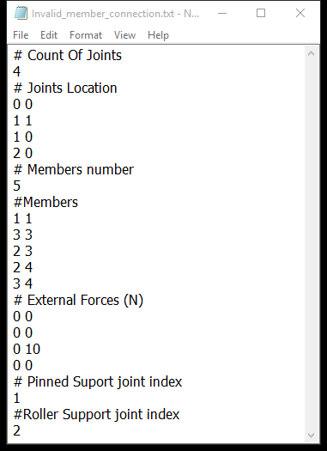
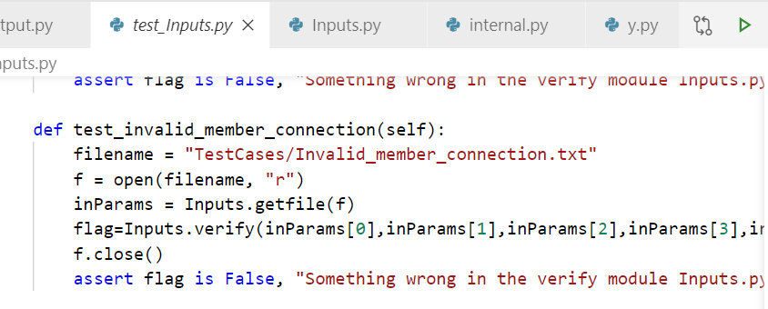


Invalid testcase: member connection

Slide 7
Correct Output Tests: Valid Testcases

Slide 8
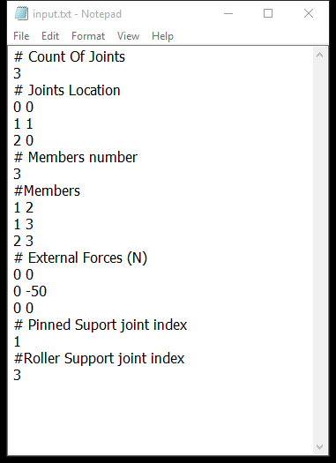
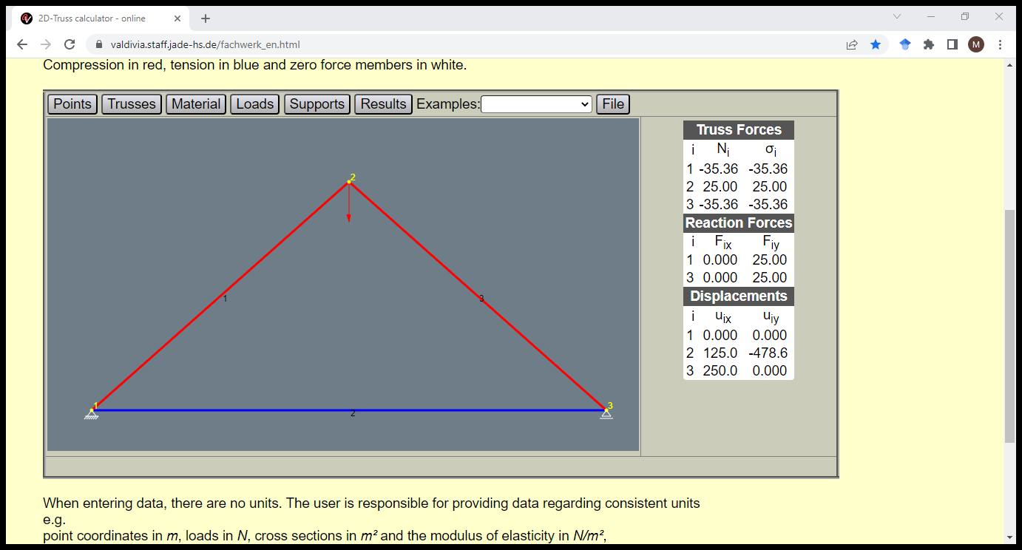
Test cases: simple truss

Slide 9
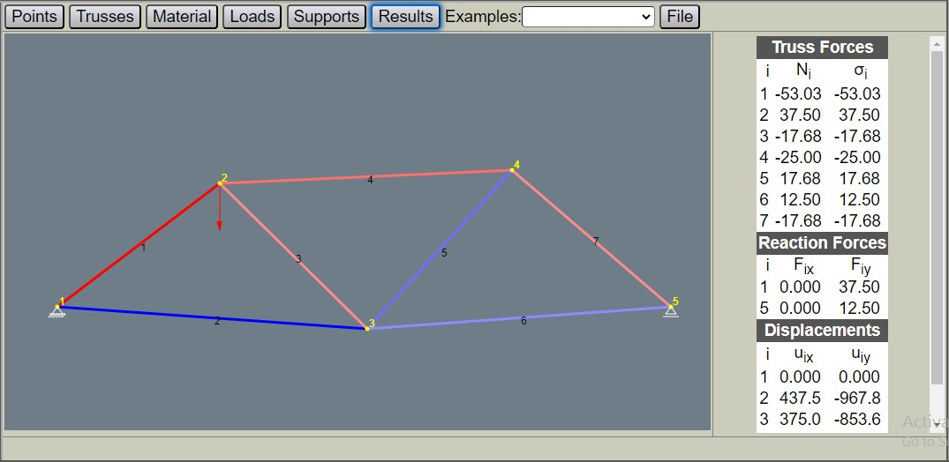
Test case: valid_n5m7

Slide 10
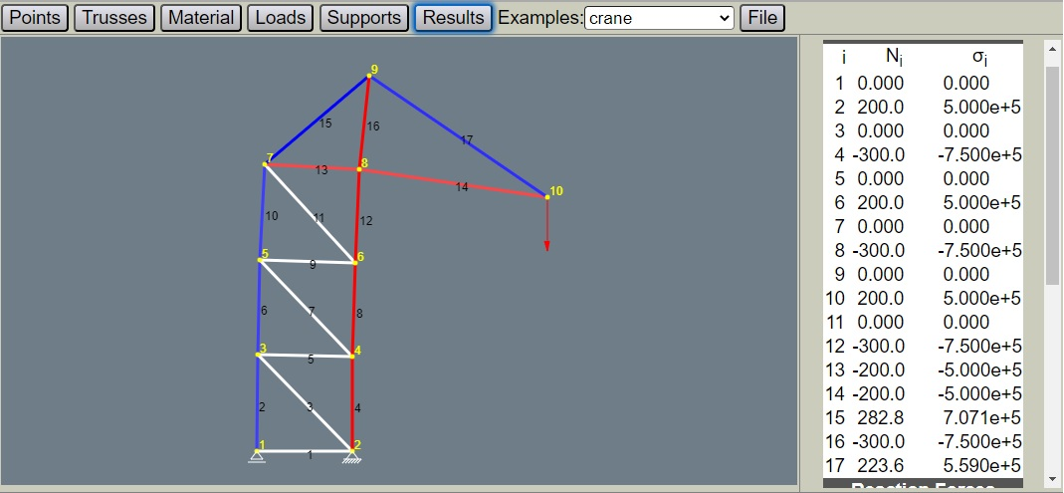
Test case: valid_crane

Slide 11
